Slide 1
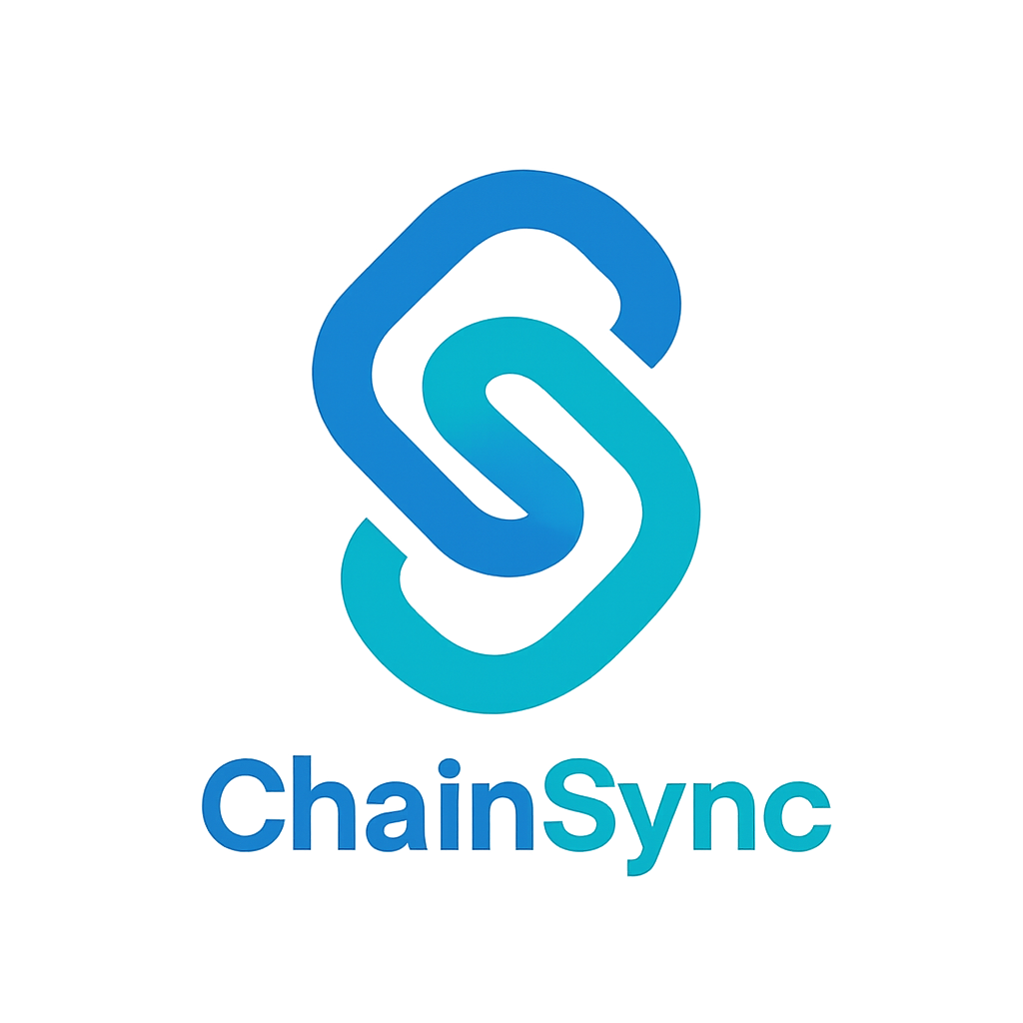

ChainSync
AI‑Powered Logistics Management
Savin.P – 2428955 Akshaya – 2428905 Brunoster Rajan – 2428913 Rajesh – 2428938 Paresh – 2428335 Tarun – 2428946 Jose Anthony – 2428954 Danish – 2428916
Business Hackathon – CIA‑3
Pitch Deck
06 Sept 2025

Slide 2
Agenda
1. Problem & Market Challenge 2. Opportunity & Growth 3. Solution Overview 4. Architecture & Workflow 5. Business Model & Canvas 6. Customer Acquisition & AWS Hosting 7. Competition & Differentiators 8. Financials & Funding 9. Conclusion & Next Steps

Slide 3

Problem & Market Challenge
Inefficient route planning increases fuel consumption and vehicle wear
Delays and manual loading lead to missed deliveries and unhappy customers
Logistics costs account for ~16% of India’s GDP – twice global benchmarks
Last‑mile delivery makes up ~53% of shipping costs, driving up prices
[1] [2] [3]

Slide 4
Opportunity & Growth
India’s logistics market projected at ₹35.3 T by 2029
8.8% CAGR through 2029 with AI in logistics growing 14%+
50,000+ logistics firms provide vast customer base
[4] [5]

Slide 5
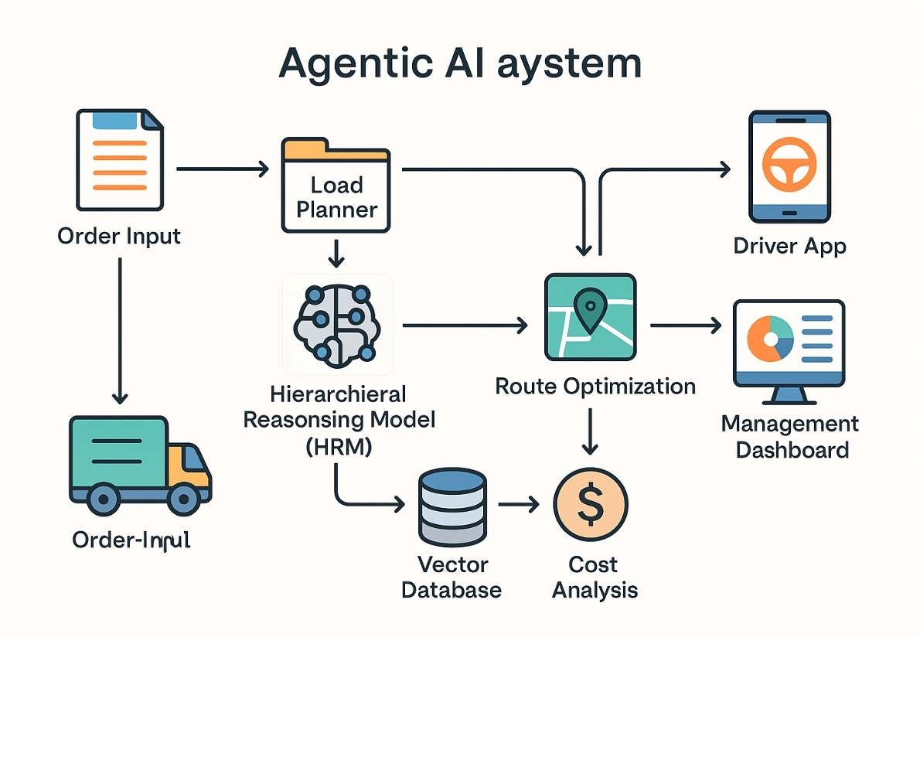
Solution Overview
Advanced AI sensors integrate traffic, weather, vehicle and demand data
Predictive analytics reroute deliveries before disruptions occur
Reduces operational costs by up to 30% and improves delivery efficiency 25–40%
Subscription model accessible from ₹15k to ₹1.5 L per month
[6] [7] [8]

Slide 6
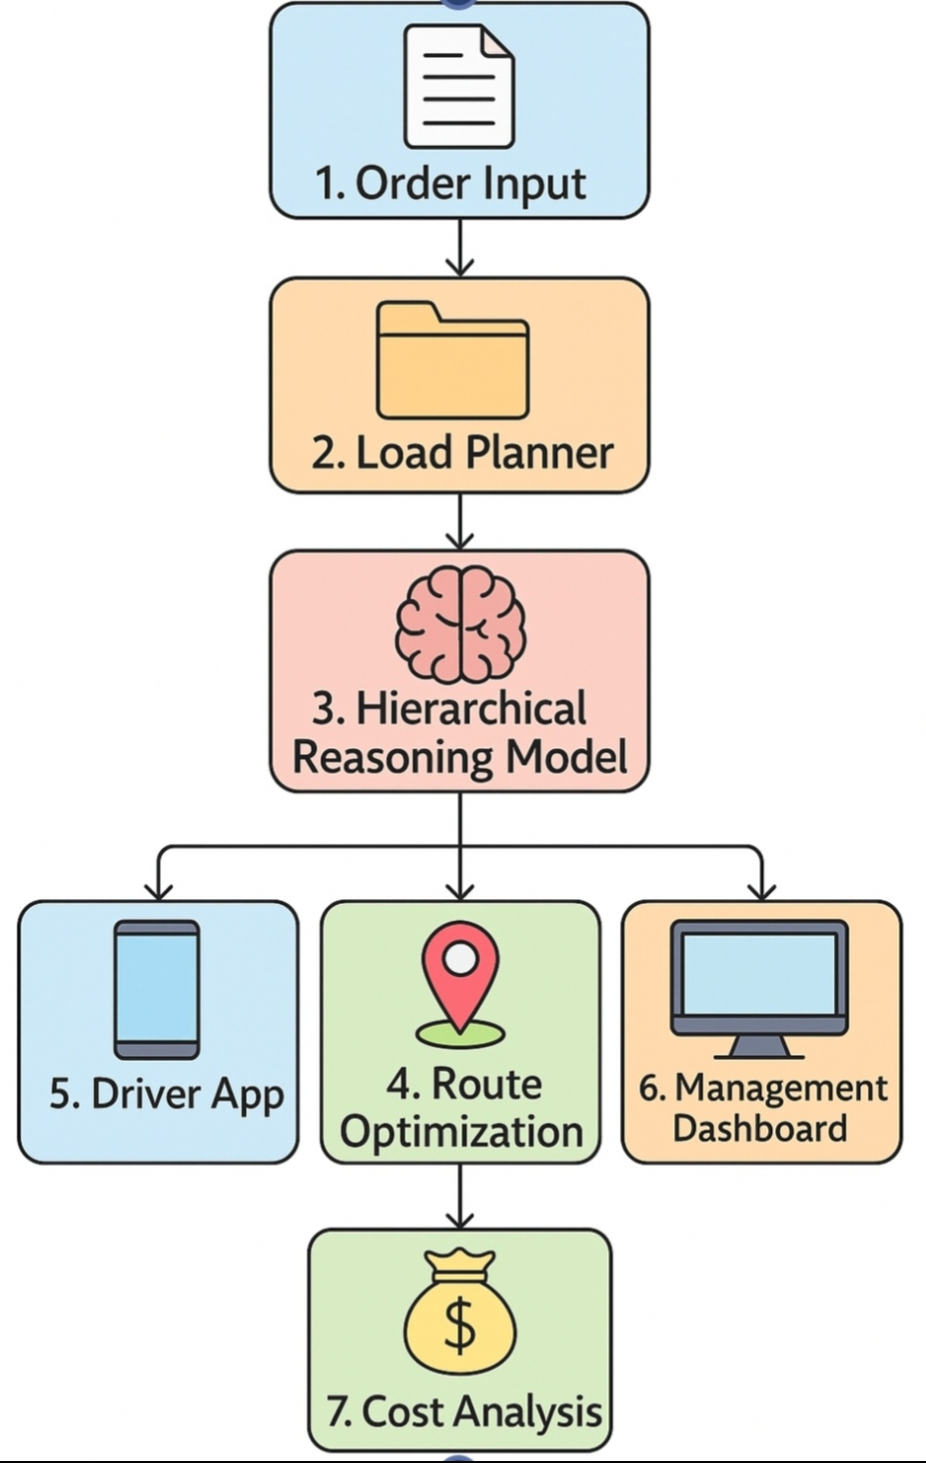
Architecture & Workflow
Orders are ingested into a load planner that constructs a packing sequence
AI core (HRM & RAG) plans loading order and reroutes in real‑time
Route optimizer updates driver app & dashboard with optimal routes
Cost analysis computes additional costs and forecasts budgets
[9] [10]

Slide 7
Business Model & Pricing
Tier | Price/mo | Features | Target
Starter | ₹15k | GPS tracking, basic route optimisation | 1–5 vehicles
Professional | ₹35k | Advanced AI routing, multi user dashboards | 6–25 vehicles
Enterprise | ₹75k | Custom algorithms, API access | 26–100 vehicles
Enterprise+ | ₹150k | White‑label, dedicated support | >100 vehicles
Savings & Value:
20–30% fuel cost reduction for small fleets
Scalable efficiency with analytics and integrations
Custom solutions & white‑label options for enterprises
[11] [12]

Slide 8
Business Model Canvas
Key Partners
Key Activities
Value Proposition
Cloud providers (AWS/Azure)
ERP & TMS vendors
Logistics associations
System integrators
AI algorithm development
Real‑time data processing
Software maintenance
Customer support
Lower costs & faster deliveries
Scalable subscription model
Comprehensive AI optimisation
Customer Segments
Channels
Revenue Streams & Costs
Small truckers & local fleets
Mid‑sized logistics firms
Large enterprises & 3PLs
Direct sales & pilot projects
Digital marketing & SEO
Partnership channels
Subscription fees
Implementation & training
Cloud infrastructure & R&D costs
[13] [14] [15]

Slide 9
Customer Acquisition & AWS Hosting
Pilot programs in Tier‑2/3 cities demonstrate ROI
Digital marketing & SEO target logistics keywords
Partnerships with logistics associations & ERP vendors
Hybrid sales: self‑serve for small firms; direct sales for larger
Instances | Cost (whole month)
1 | $0 + storage
2 | $10.64
5 | $51.85
10 | $112.50
AWS Free Tier:
750 hours/month of t2.micro & t3.micro instances
Run one instance 24/7 with up to 30 GB EBS storage free
Scale gradually; pay only when additional instances are needed
[16] [17] [18]

Slide 10
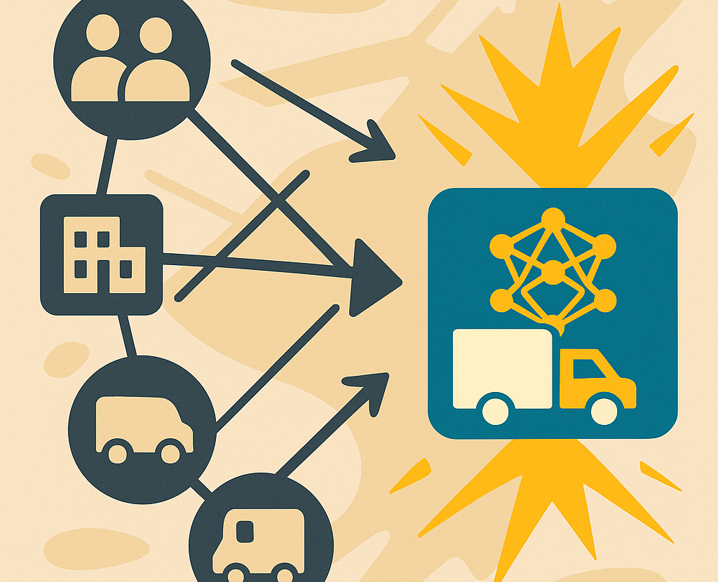
Competition & Differentiators
Competitors:
LogiNext – AI logistics SaaS (founded 2014)
Locus – route optimisation & last‑mile (founded 2015)
Pickrr – multi‑carrier shipping platform (2015) Our Edge:
Real‑time AI sensor integration & multi‑objective optimisation
Tiered subscription model serving all segments
End‑to‑end solution from order input to cost analysis
[19] [20]

Slide 11
Financials & Funding
Funding & Profitability:
Development cost: ₹95.5 L; operations: ₹15 L; total ₹1.1 Cr
Seed: ₹2–3 Cr; Series A: ₹8–12 Cr; Series B: ₹25–35 Cr
Breakeven in year 1 with cumulative profit of ₹2.3 Cr
[21] [22] [23] [24]

Slide 12
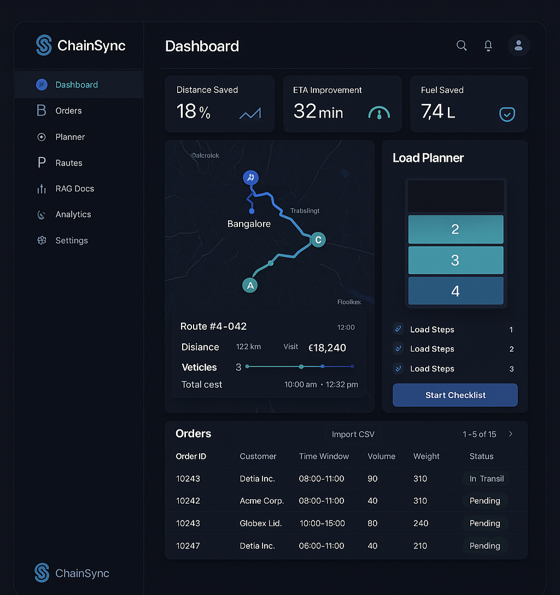
Conclusion & Next Steps
ChainSync solves critical logistics inefficiencies with AI & RAG
Massive market and rapid growth create huge opportunity
Sustainable business model with proven profitability
Next: build MVP, secure pilot customers and raise seed funding
[25] [26] [27]

Slide 13
AWS Hosting & Scaling Plan
Kubernetes on Amazon EKS enables horizontal scaling across worker nodes.
EKS control plane costs about $0.10 per hour (≈₹5,976/month).
Worker nodes: t3.medium (2 vCPUs, 4 GiB) cost $0.0416 per hour (≈₹2,486/node/month); start with three nodes.
AI model served on g4dn.xlarge GPU during peak hours at $0.526 per hour (≈₹10,478/month).
Storage: 100 GB EBS (gp3) ≈ $8 per month (≈₹664).
Total ~₹24,576/month for compute & storage; scale horizontally by adding nodes when demand increases.
Optimise costs using spot instances and auto‑scaling.
Component | USD/mo | INR/mo
EKS control plane | $72.00 | ₹5,976
3× t3.medium workers | $89.86 | ₹7,458
g4dn.xlarge GPU | $126.24 | ₹10,478
100 GB EBS | $8.00 | ₹664
Total | $296.10 | ₹24,576
[28] [29] [30] [31] [32]

Slide 14
Free Tier & Credits
AWS Free Tier provides 750 hours/month of t2.micro and t3.micro instances and 5 GB S3 storage.
Supports running a single micro instance 24/7 with modest storage; running multiple instances exceeds free allocation quickly.
AWS Activate credits award $1,000–$300,000 to eligible startups.
Partner programs (Mercury Bank, BEAMSTART) offer additional $5k–$10k in credits.
Plan: Apply for Activate and partner credits to cover 6 months of cloud costs and leverage free tier for non‑critical workloads.
6‑Month Free Strategy
Use free tier micro instance for dev/test workloads.
Deploy production on credits; no out‑of‑pocket cost for 6 months.
After credits, switch to autoscaled spot instances for cost efficiency.
[33] [34] [35] [36]

Slide 15
Initial Investment & Financial Plan
Compute & Storage (6 mo): ₹147,456
Marketing & Outreach: ₹60,000
Admin & R&D: ₹40,000
Buffer Reserve: ₹50,000
Total initial investment: ₹297,456
Leverage AWS credits to cover cloud costs
during first six months.
Allocate marketing funds to digital campaigns and pilot demos.
Use contingency reserve to handle unexpected
expenses and scale.
[37] [38] [39] [40]

